Slide 1

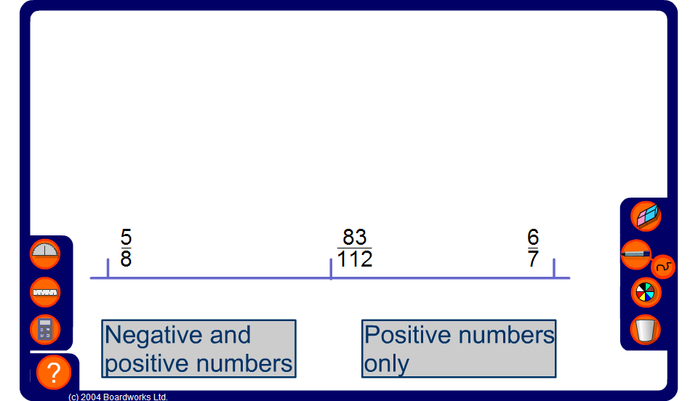


Mid-points
Notes:
Start by revealing all three fractions and ask pupils to explain (using equivalent fractions or otherwise) how we can tell that the fraction in the centre is exactly half-way between the other two.
Reset the activity, reveal two of the fractions on the line and challenge pupils to find the hidden fraction.
Links:
D2 Processing data - Calculating the mean; Finding the median.
N1 Place value, ordering and rounding - Ordering decimals.
N2 Negative numbers - Ordering integers.

